Slide 1
EPIC FMS
A Field Management System (FMS) for the Fall Game
Epic Robotz
Fall 2021
This stack contains useful info about various parts of EpicFMS.

Slide 2

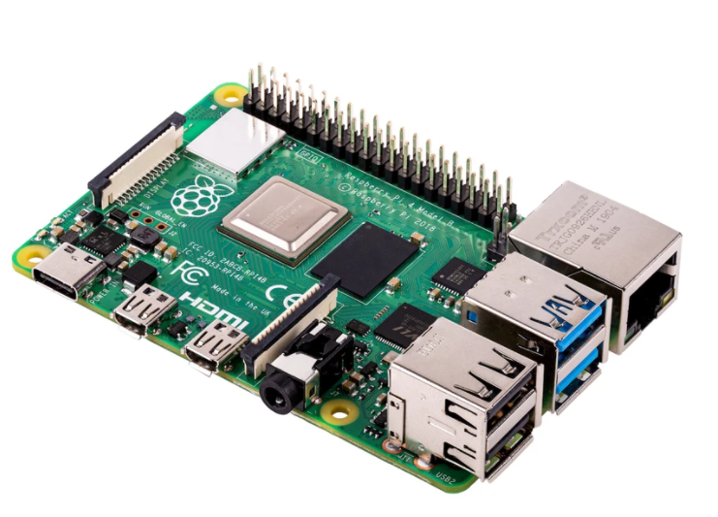


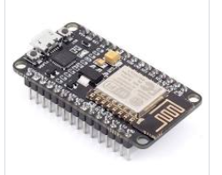
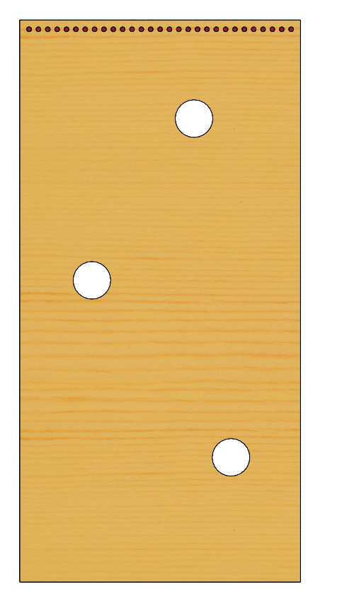
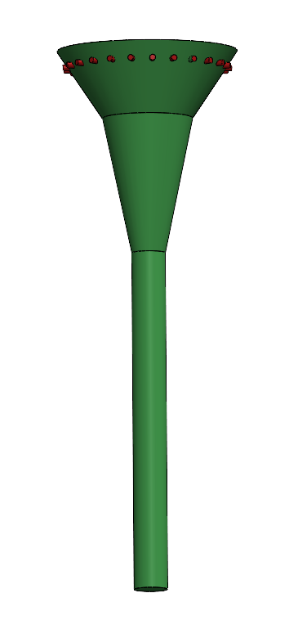
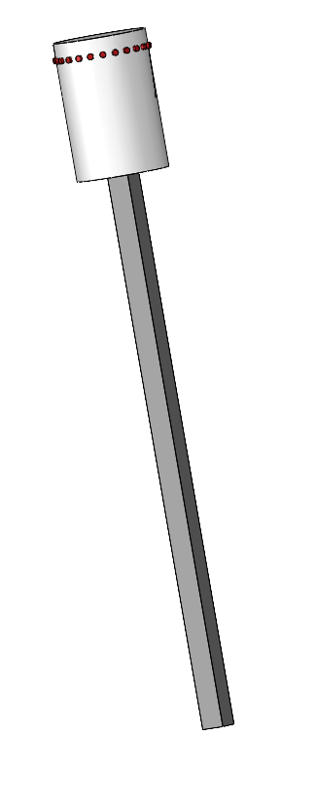
EPIC Robotz FMS System for the Fall 2021 Intramural Game
EPIC Robotz Internal Wired LAN
EPIC GAME SCORE
(Website)
T
Game Management (Website)
T
Main FMS Server
Provides Web site for game Admin,
And Score Board across wired LAN.
Also provides AP with ssid=epicfms
for communication with field elements.
Web Client for Audience Score Board
FMS Administrator
Field Elements:
Each Field Element has a ESP8266 wifi
Module for communication with the
Main FMS Server. The comm is across
a private LAN created by the server.
The server uses DHCP to assign IP
Addresses. The server then collects
Score counts from each ESP8266 in
real time, and sends commands
back to the ESP8266 to control the
NeoPixels, servos, and motors
the game elements.

Slide 3
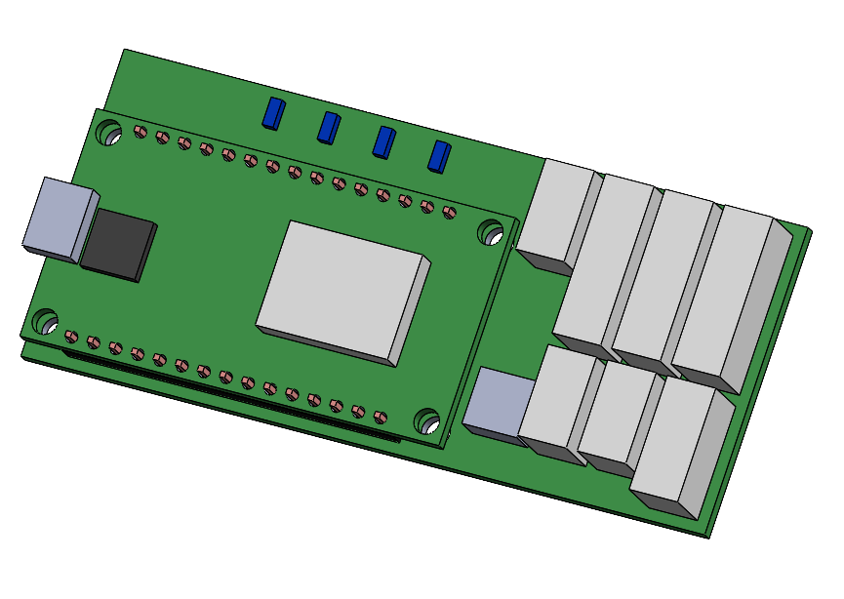
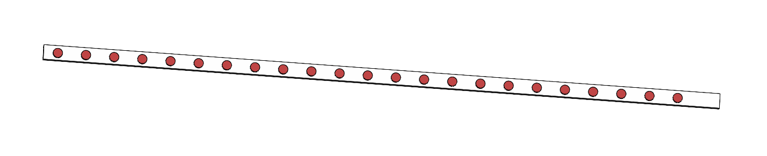
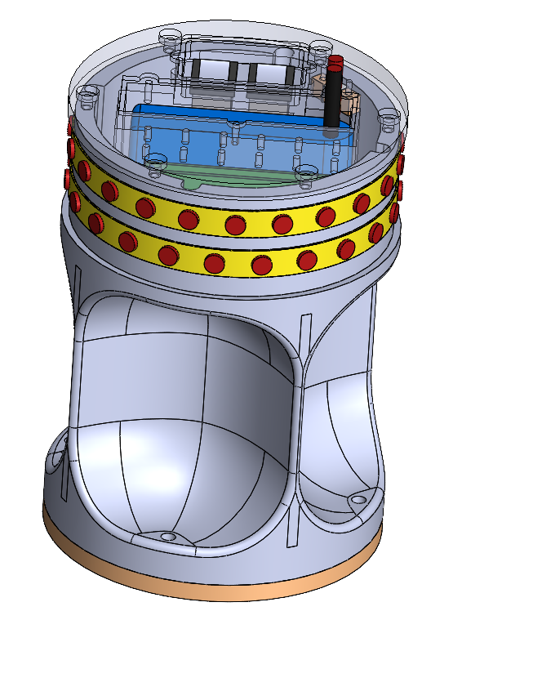
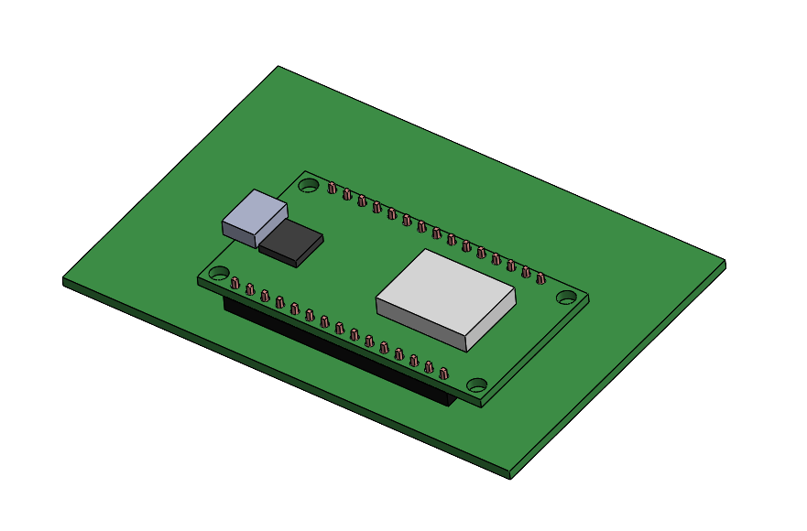
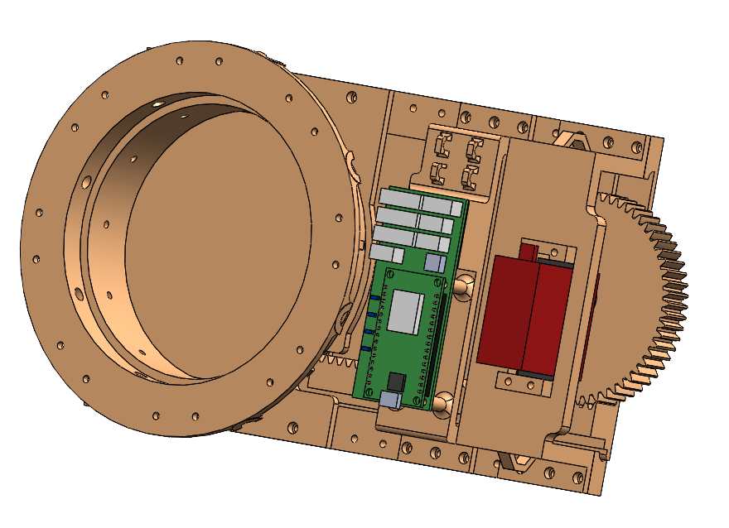
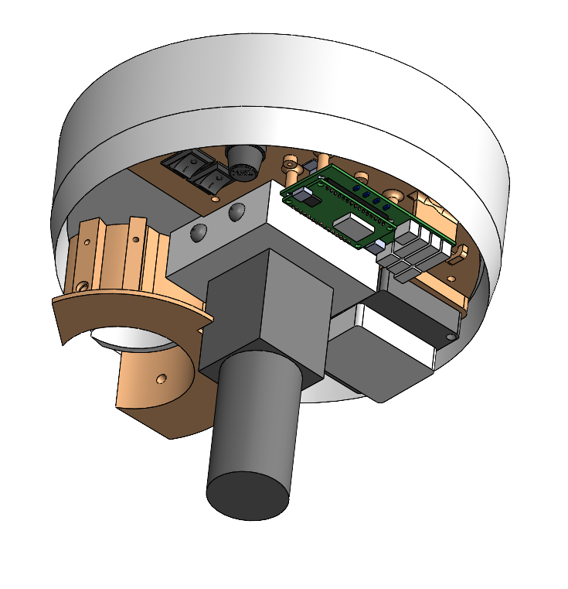
Overview of Electronics for Field Elements
Target Board Conductor Unit
This is a hand soldered circuit board.
See “Target Board Conductor Schematic”
Two versions (V1, V2) of a PCB were manufactured to support EpicFMS.
The schematics for these PCBs are named “Moving Target Unit, V4” and
“Moving Target Unit, V5”, respectively.
These feature an ESP8266 for WiFi.
Target Board
The Target Boards features 3 targets
that can open and close on command from the EpicFMS server. In addition,
there is a strip of NEO LEDs at the stop,
also controlled by the server.
Sliding Target Unit
Each of these uses a V2 PCB, and
is wired according to the
“Sliding Target Wiring Schematic”
These slider units do not use their
WiFi capability, but instead communicate
with the Target Board Conductor via SPI
over a ribbon cable. The ribbon cable also
supplies power to these units.
Power 7-9 volts DC @ 5 amps, either from 2S Lipo, or AC wall wart.
Moving Target Unit
These units use V2 of the PCB,
And are wired according to
“Moving Target Wiring Schematic”
Power to this unit is an internal
2S Lipo battery.
Basket Target Unit
These units use V1 of the PCB,
And are wired according to
“Basket Wiring Schematic”
Power to this unit is 12 volts
DC @ 10 amps, either from a
3S Lipo Battery, or an AC Wall Wart.
18 AWG, 6 Conductor Ribbon Cable (x3)
= WiFi Enabled Device

Slide 4
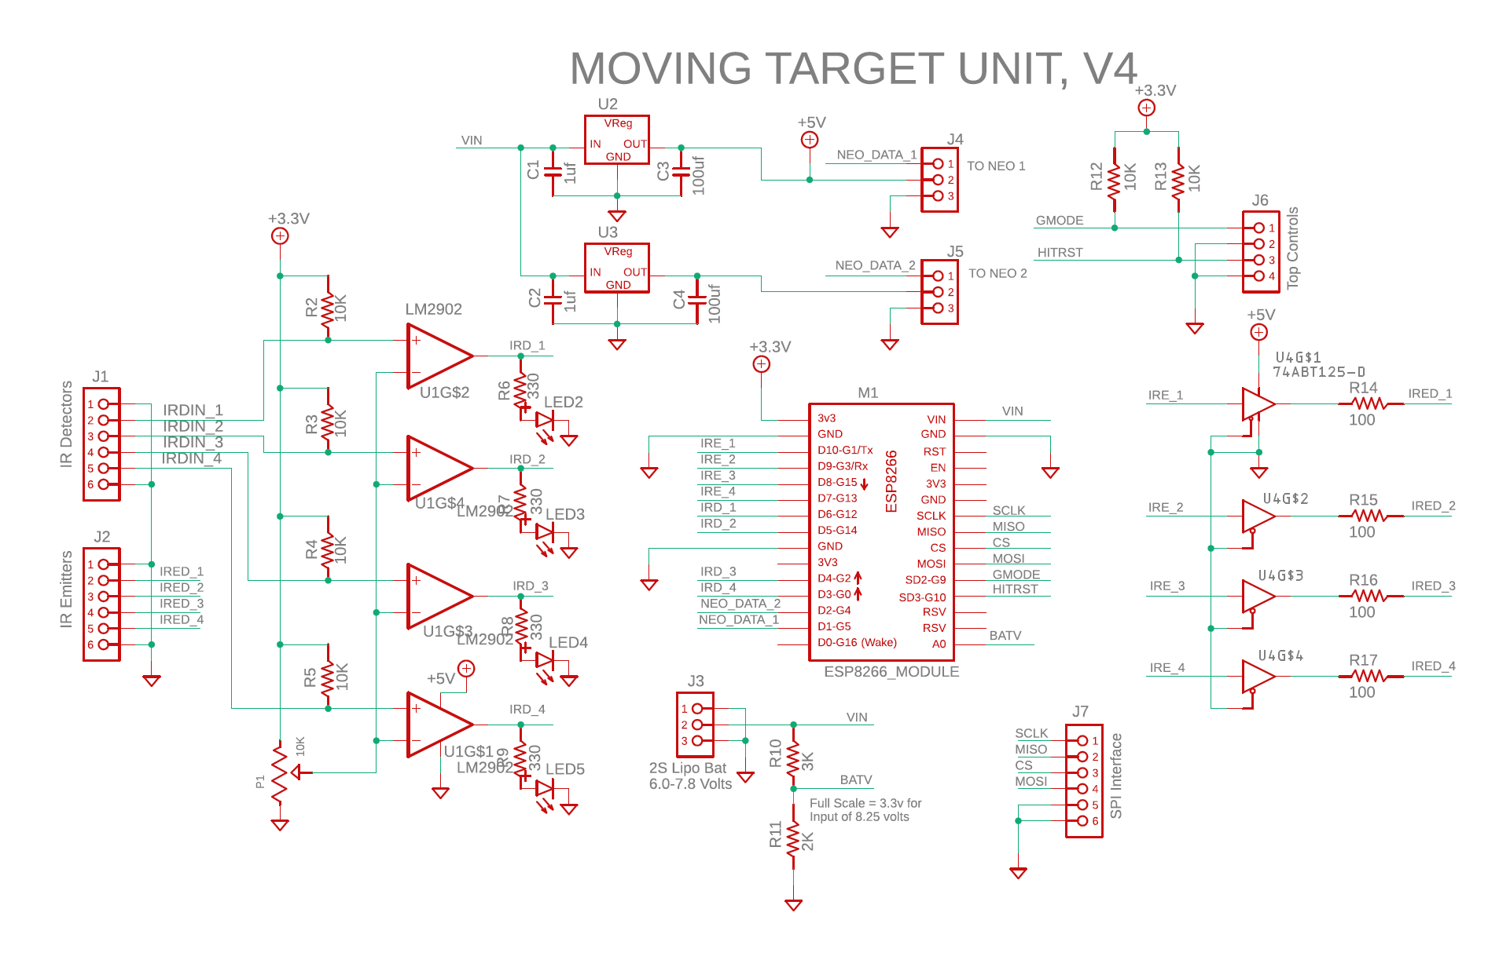
PCB Schematic, V1
V1 of the PCB was manufactured
from this schematic.

Slide 5
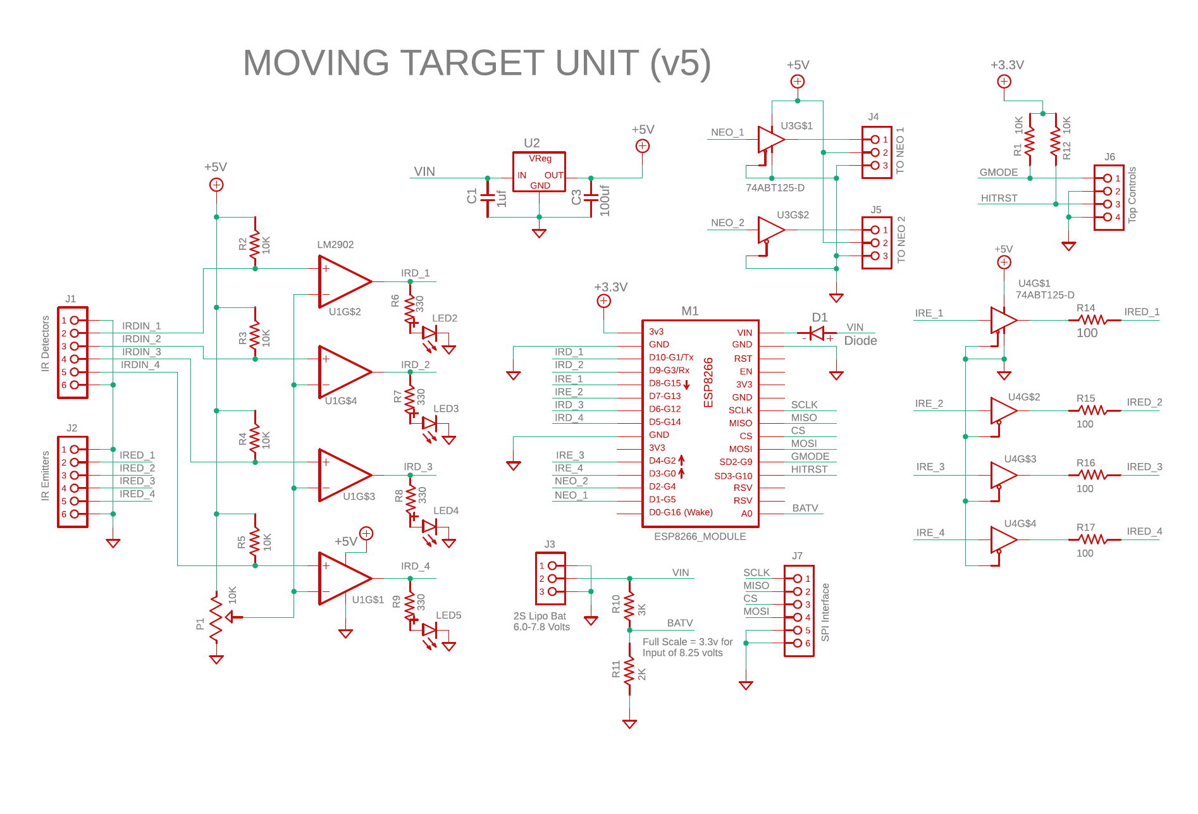
PCB Schematic, V2
V2 of the PCB was manufactured
from this schematic.

Slide 6
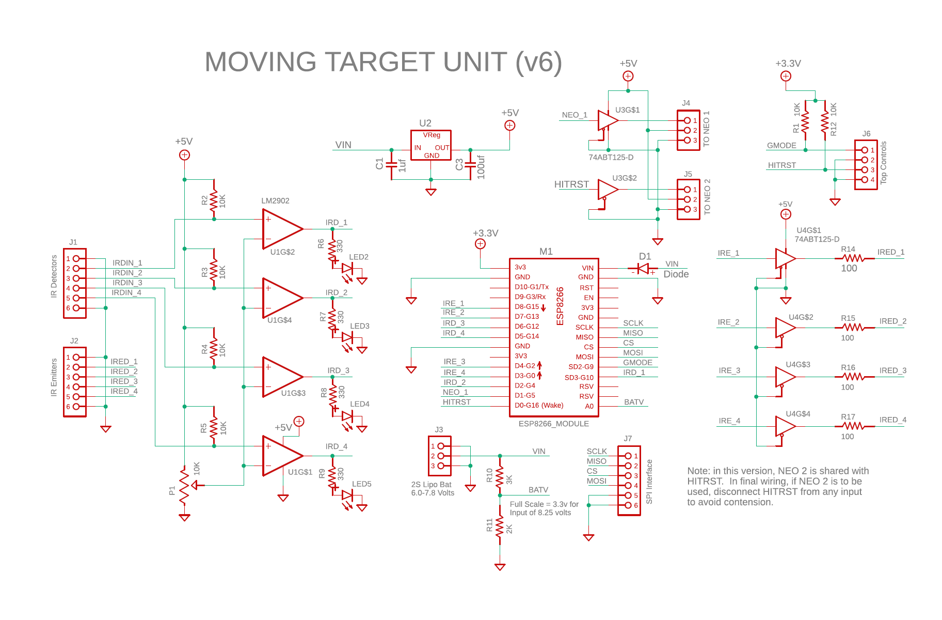
PCB Schematic, V3
The V2 PCBs were modified
to be this circuit. V3 is the
version used in most units.

Slide 7
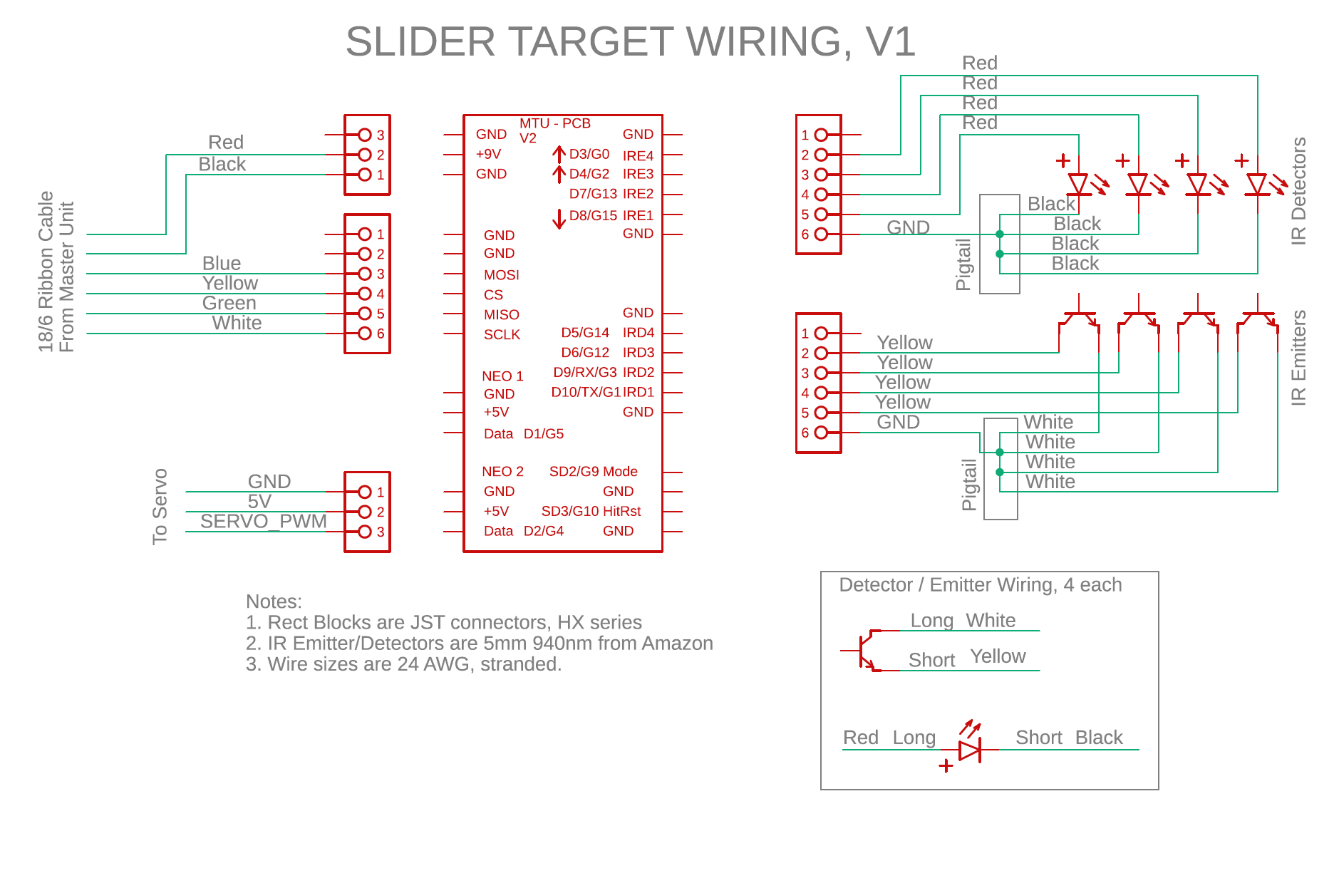
Sliding Target Wiring Schematic

Slide 8
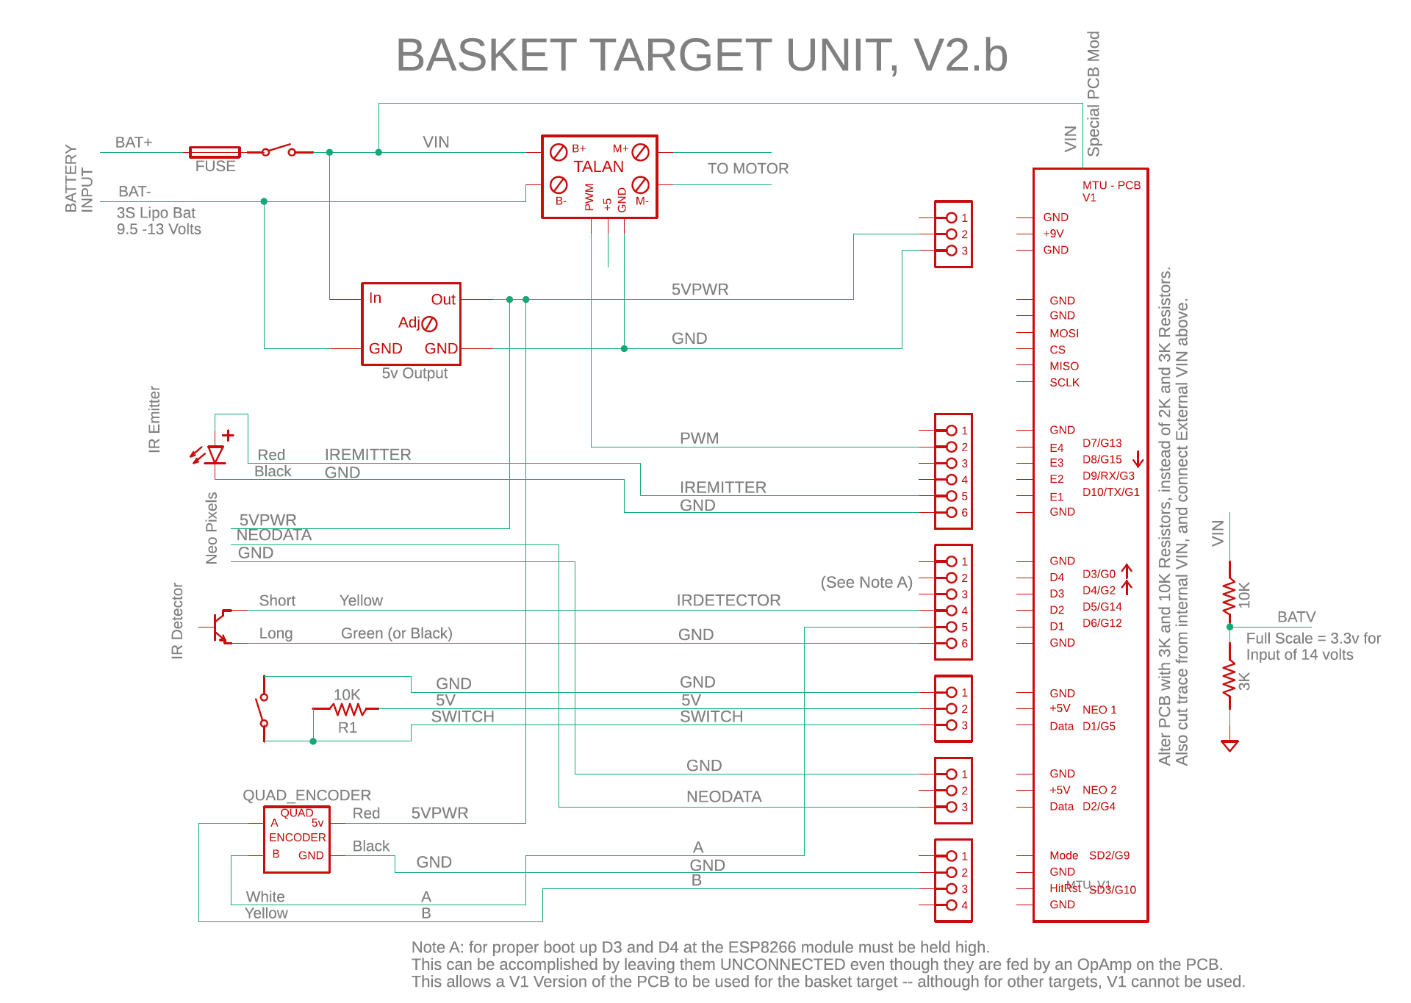
Basket Target Wiring Schematic

Slide 9
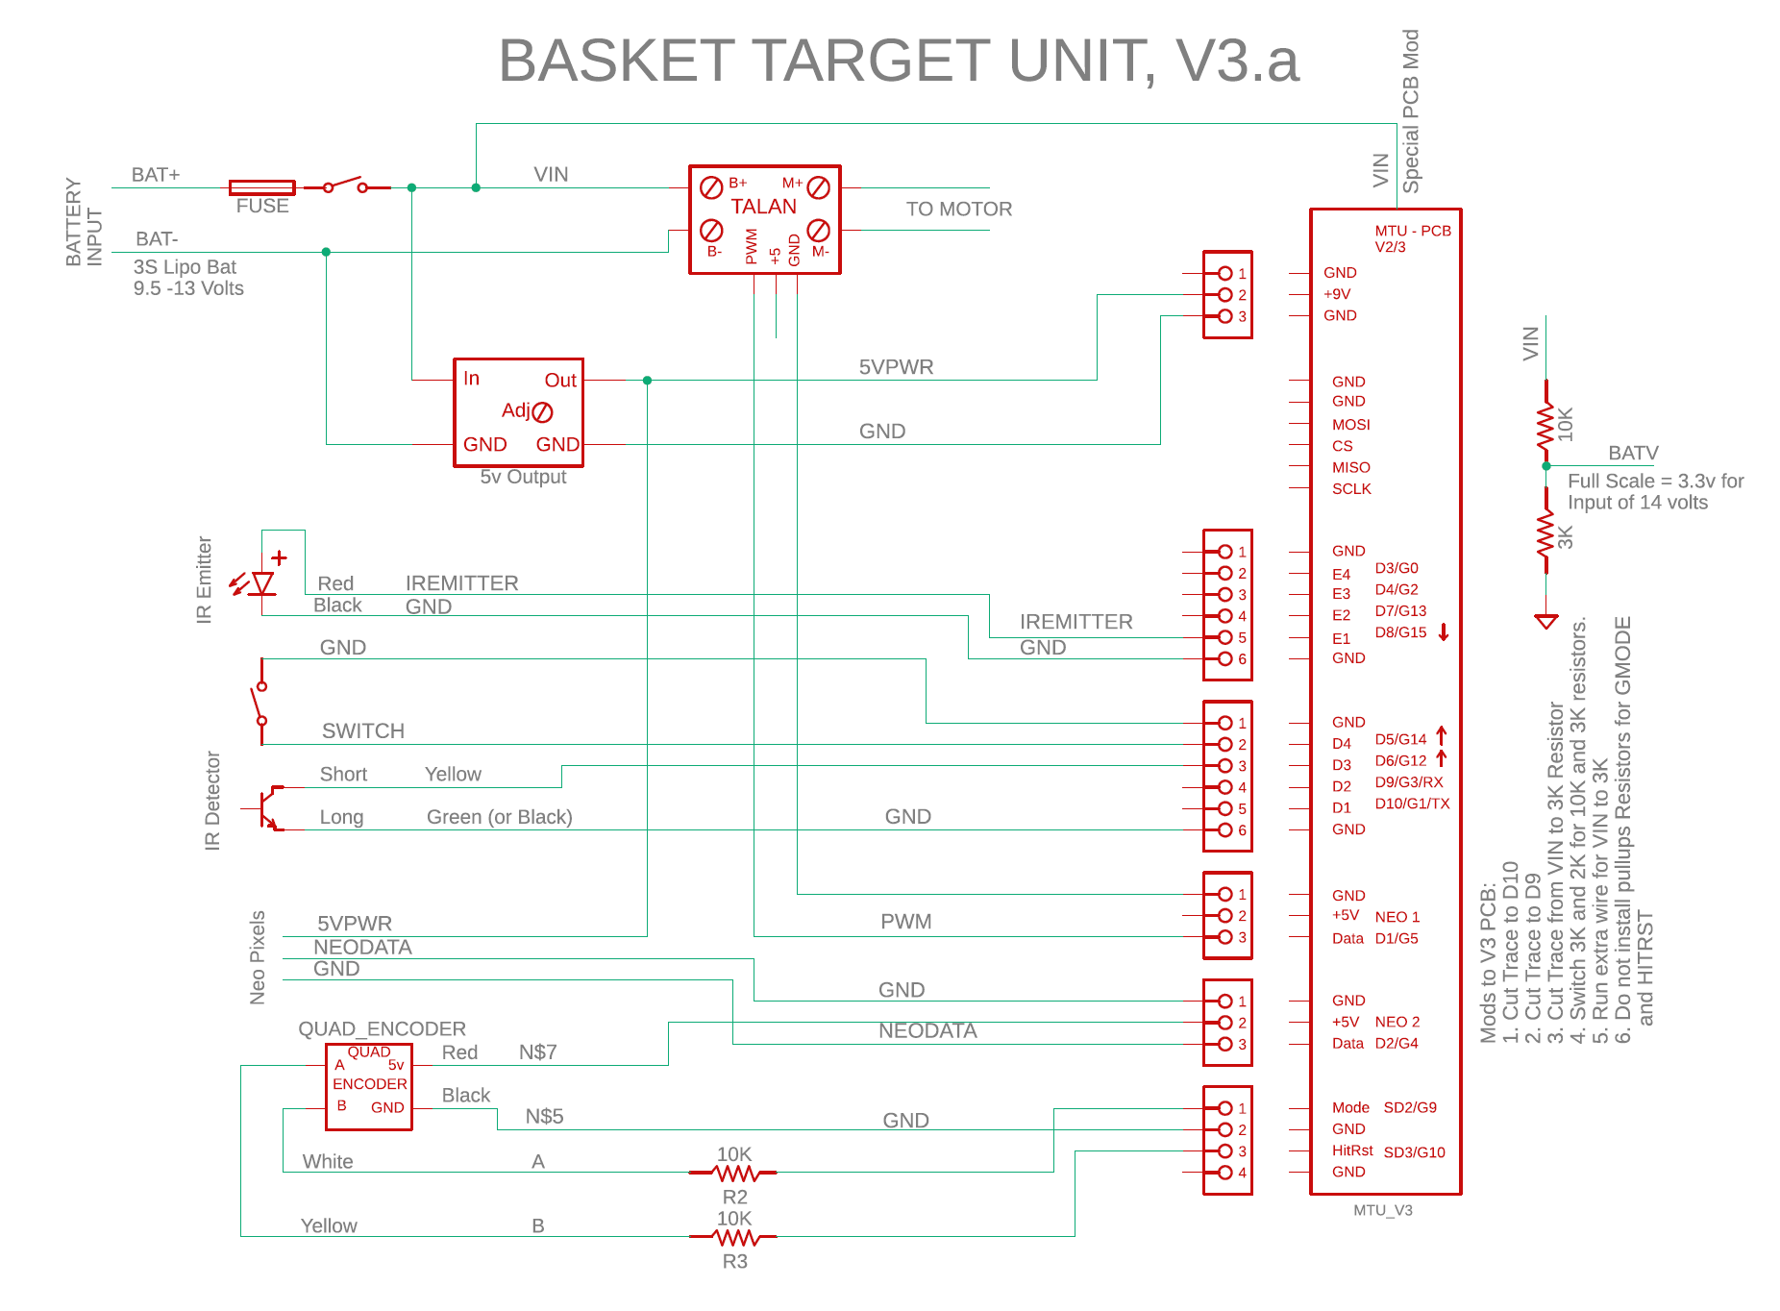
Basket Target Wiring, Version Based on V2 of PCB
Coming Soon, I Hope.

Slide 10
Moving Target Wiring Schematic
Coming Soon, I Hope.

Slide 11
KNOWN Issues with the EPS8266
What as been learned through experimenting and study:
1. DO NOT USE the "D" numbers such as D0, D1, etc when specifying pins.
2. Pins seem to always be specified with the G numbers.
3. If you want a serial port to upload code and debug,
DO NOT USE D9 and D10 for any circuitry.
4. D0/G16 is connected to the on-board LED.
5. D0/G16 cannot be used for PWM or Interrupts!
6. D0/G16 cannot be used for NEO pixels!
7. D0/G16 can be used to turn on/off a simple LED
8. D1, D2, D3, D4, D5, D6, D7, D8, and SS3 all work with interrupts.
9. Startup problems and upload problems are likely if you use D0.

Slide 12
MOVEING TARGET CIRCUIT BOARD CONNECTORS
Gnd
Gnd
Gnd
Gnd
+7-9v
Gnd
E4
D4
Battery In
Gnd
MOSI
E3
D3
SPI
IR Emitters
IR Detectors
CS
E2
D2
MISO
E1
D1
SCLK
Gnd
Gnd
USB
ESP8266 Module
Mode
Switches
+5v
+5v
Gnd
Neo Pixels 1
Neo Pixels 2
Data
Data
HRst
Gnd

Slide 13
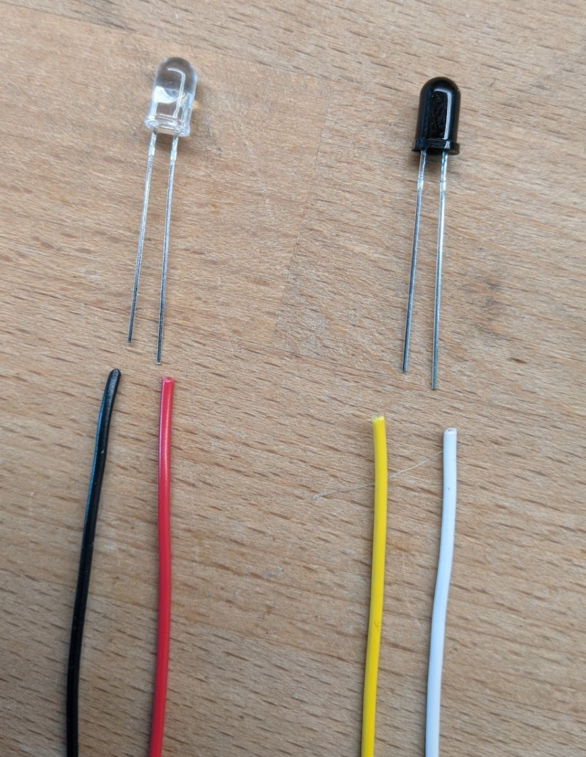
Wiring IR Emitter/Detectors
The CLEAR LED is the Emitter.
Our circuit sends about 17ma of current through this device.
The RED wire carries positive voltage and must be connected to the LONG lead.
The BLACK wire should be connected to the SHORT lead.
Use 24-26 AWG stranded wire.
The Dark Component is the Detector.
When it detects IR light, it allows
current to flow between it’s leads, but
in only one direction: from the short lead
to the long lead.
The YELLOW wire is the positive side and
Must be connected to the SHORT lead.
The WHITE wire is the negative side and
Must be connected to the LONG lead.

Slide 14
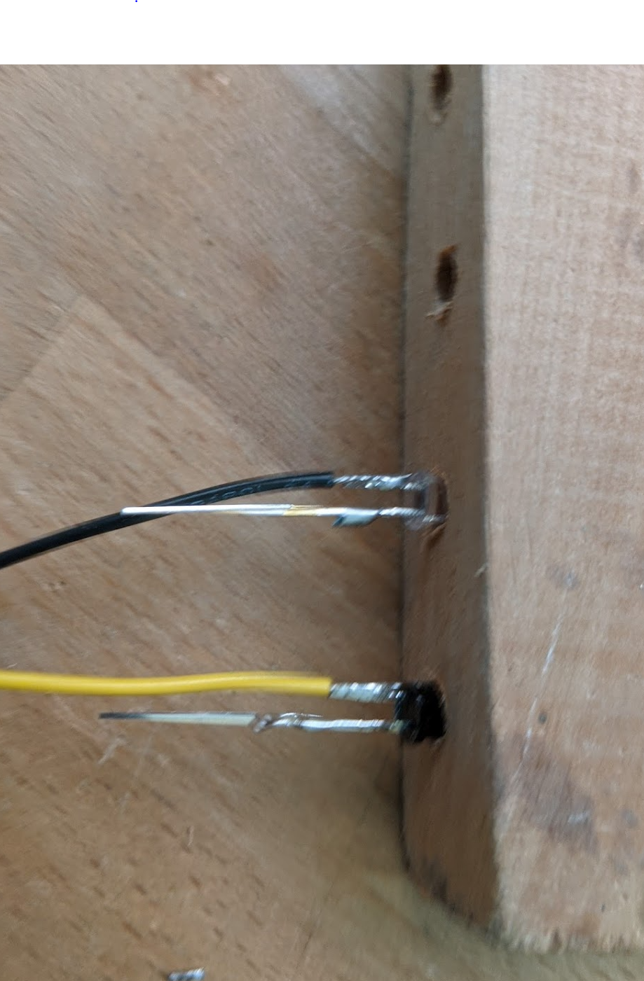
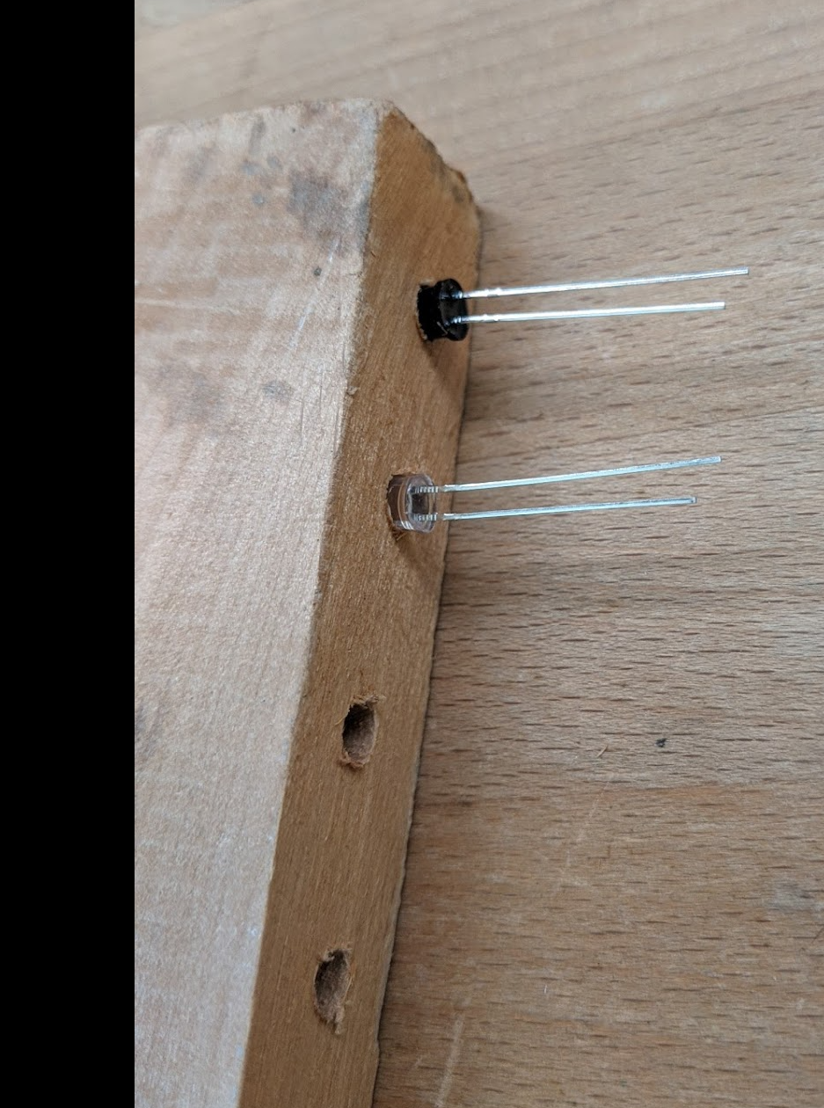
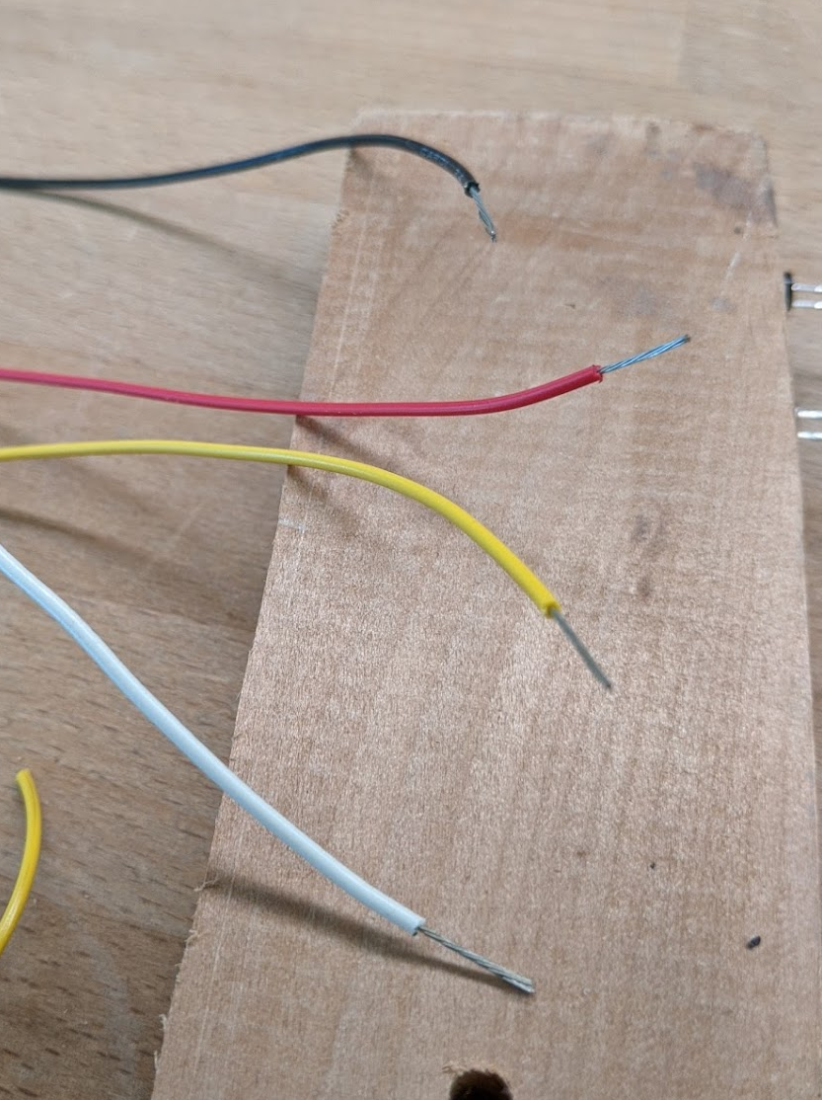
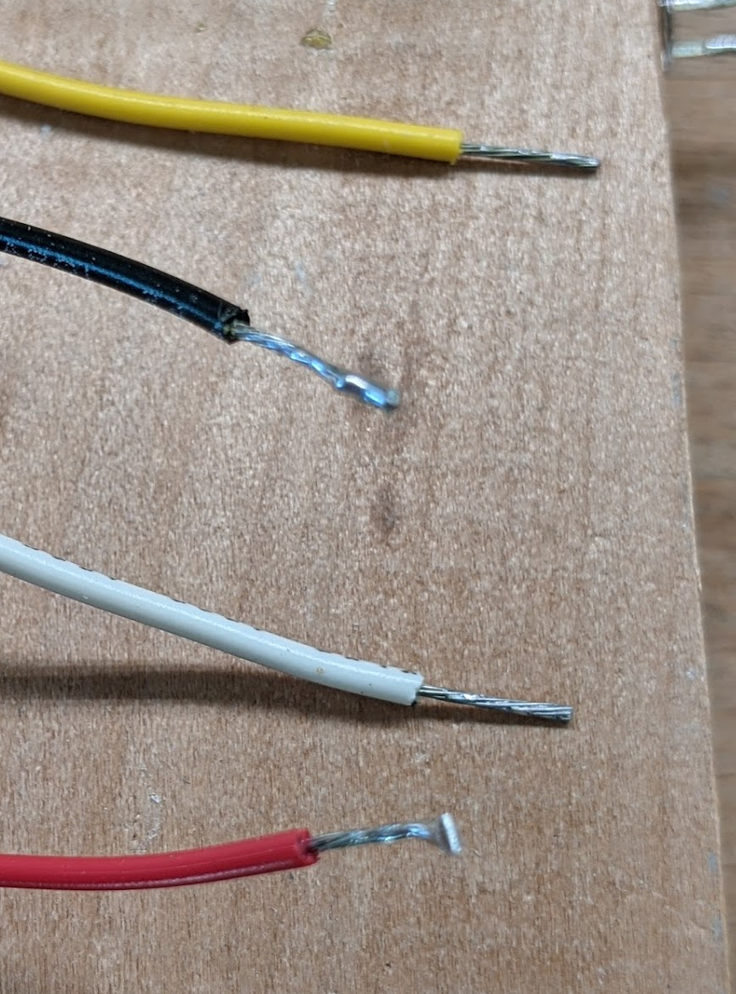
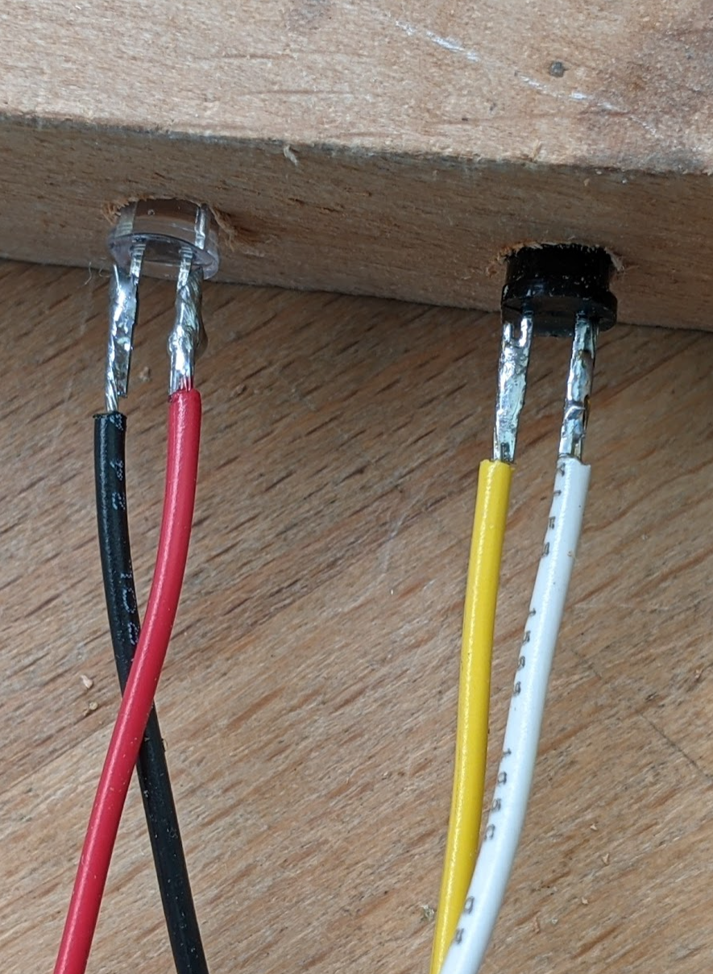
Steps to Solder Wires to the IR Components
Start with the components in the soldering jig with the long leads nearer the top of the jig.
Strip about 0.5 inch of insulation from each wire.
Tin all wires and leads. Then trim the wires so that there is about 3/8 inch of conductor showing.
Cut the short leads to about 3/8 inch. And then use the parallel solder technique to solder the wires.
Do the same for the long leads.
Parallel solder technique: After tinning both wire and lead, bring the wire along side of the lead (i.e., parallel to it), and then heat both with the soldering iron at the same time. Allow the solder to flow between the lead and the wire while holding the wire very steady. Remove the soldering iron while keeping the wire absolutely still until the solder cools.

Slide 15
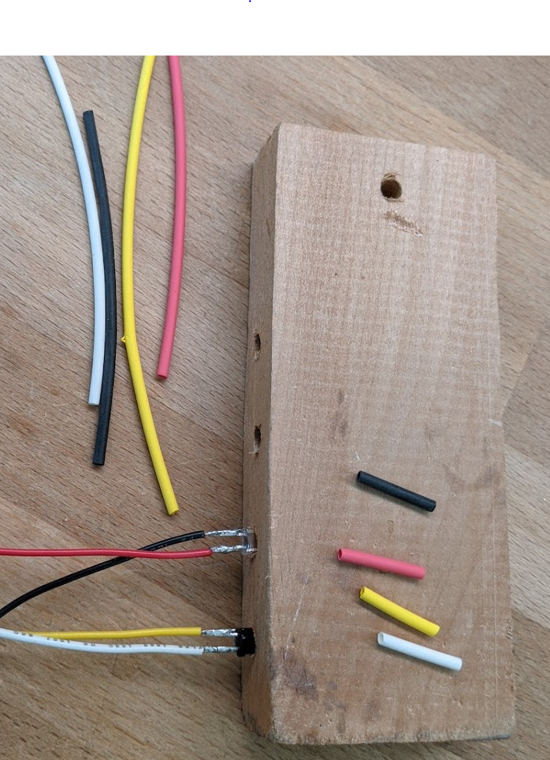
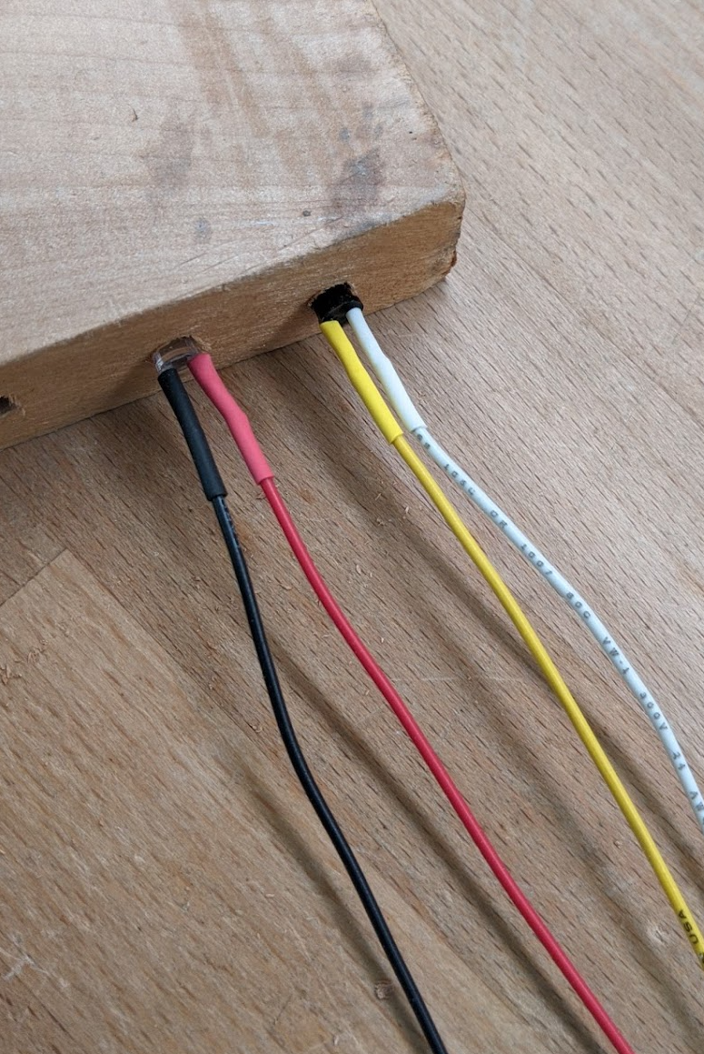
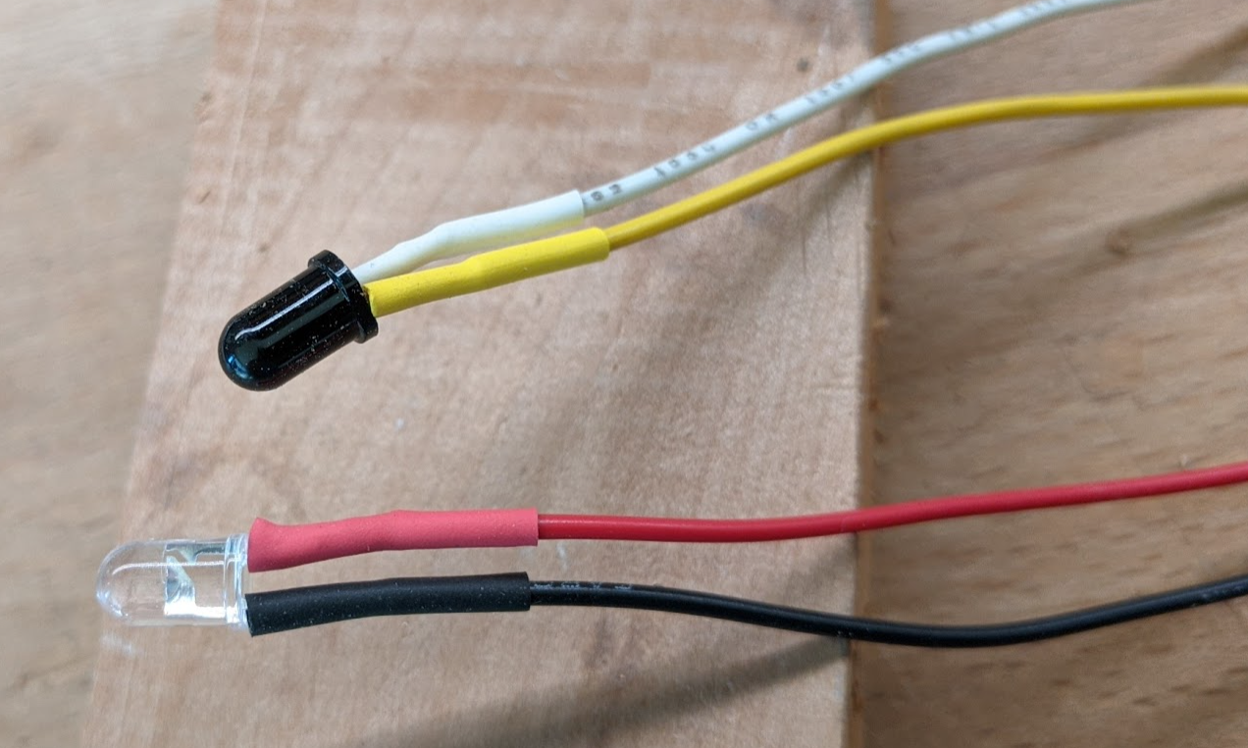
Steps to Finish the Soldered IR Components
Cut about 5/8” of heat shrink tubing for each wire. Try to use the same color. Use 1/16 “ diameter tubing (measured before heat applied).
Slide the heat shrink tubing on each wire all the way to the component. Apply heat with a heat gun. Don’t use a match!
All Done!

Slide 16
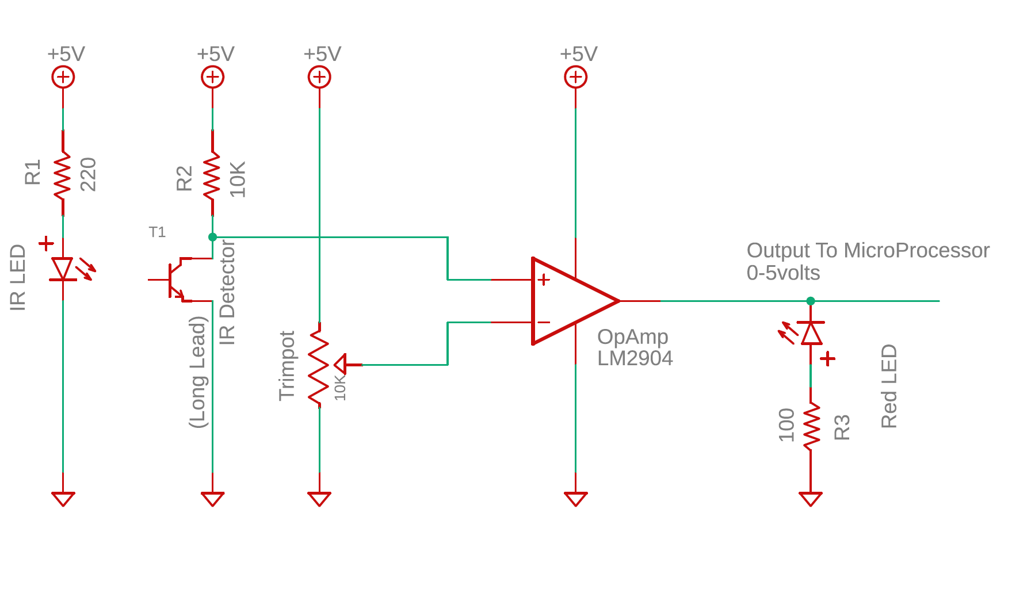
IR Emitter / Detector Test Circuit
Notes:
The IR Emitter, as shown with a 220 ohm resistor draws about 17 mA.
The voltage at the + terminal on the OpAmp runs between 0.12 volts when the beam is detected, and 3.5 volts when the beam is broken.
The OpAmp is wired as a simple comparator. It outputs a hard 0 volts if the beam is detected, and about 3.5 volts if the beam is broken.
The Red LED after the OpAmp is included to indicate when the beam is broken.

Slide 17
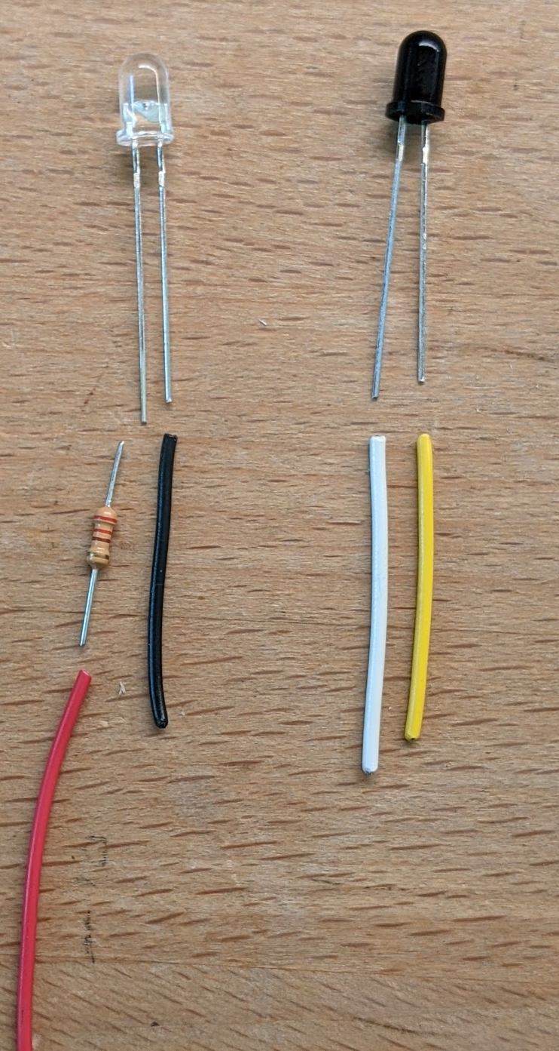
IR Emitter / Detector Wiring
OBSOLETE!! Design Changed.
The Clear LED is the Emitter.
Connect a Red wire to a 220 ohm resister and then to the long lead. On the short lead, connect a black wire.
Use 24-26 AWG stranded wire.
When powered with 5 volts,
Each emitter will draw about 14 mA.
The Dark Blub Component is the Detector.
Connect a white wire to the long lead. Connect a yellow wire to the short lead.
Use 24-26 AWG stranded wire.
In the circuit, the white lead will be connected to ground. When the detector is “on”, current will flow from the yellow wire though the detector to ground.

Slide 18
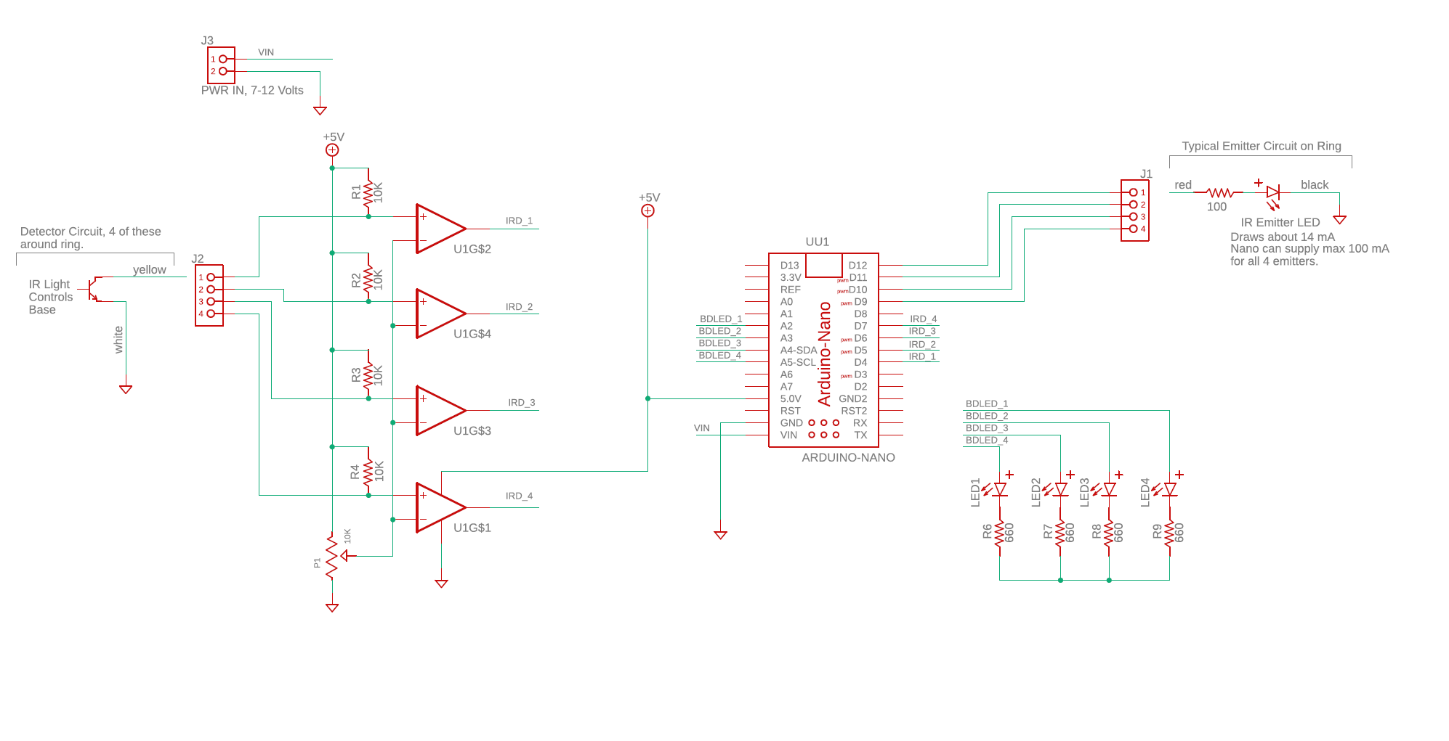
Ring Detection Circuit, Version 1
This circuit was used in early development to test IR detection. It is
not part of the final system.

Slide 19
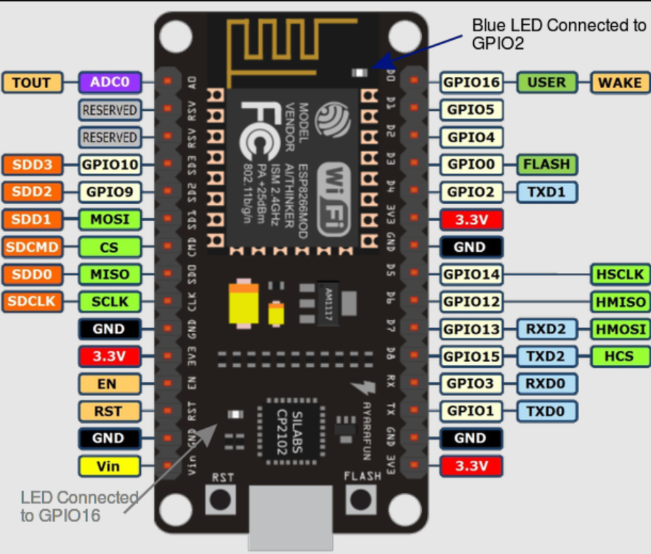
Pinout for nodeMCU

Slide 20
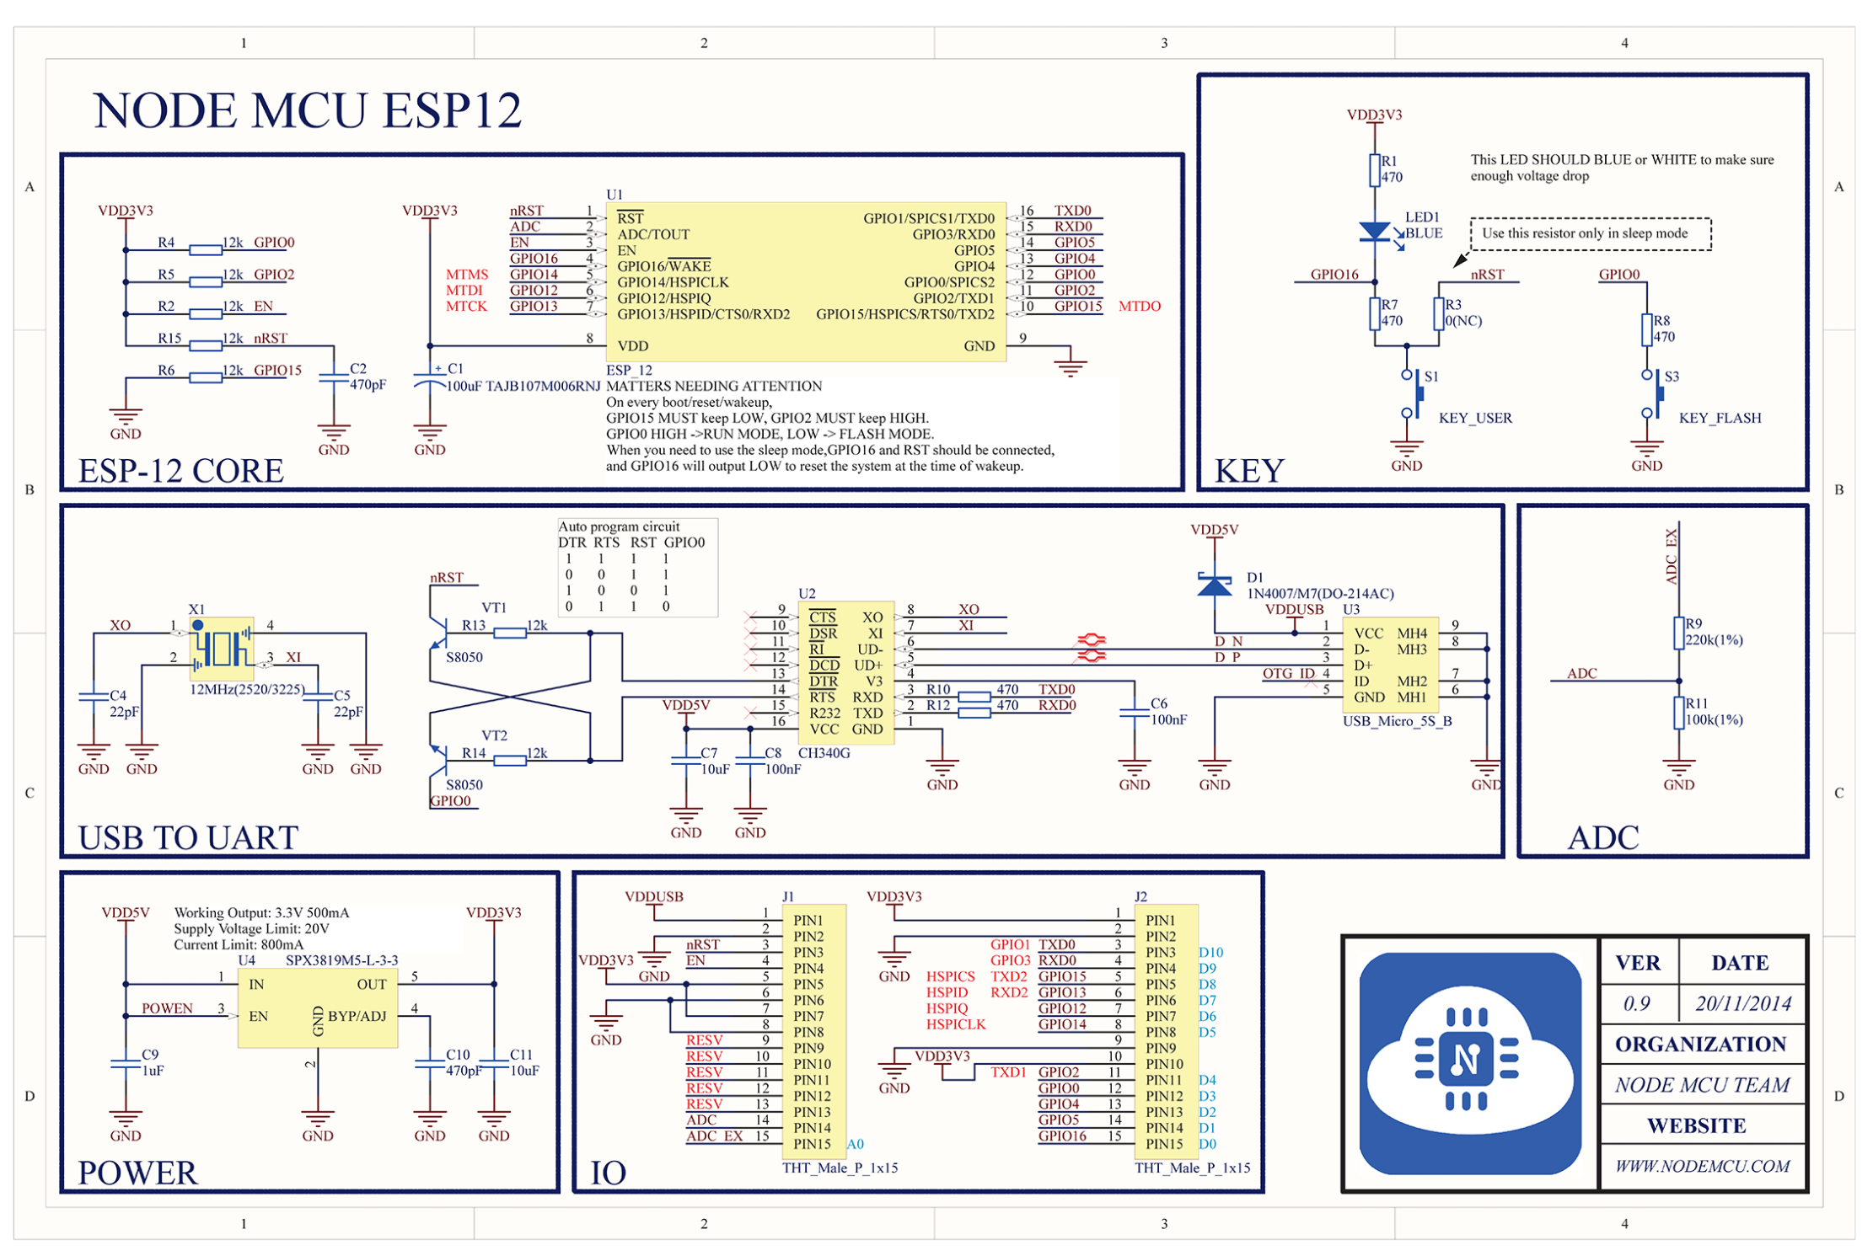

Slide 21
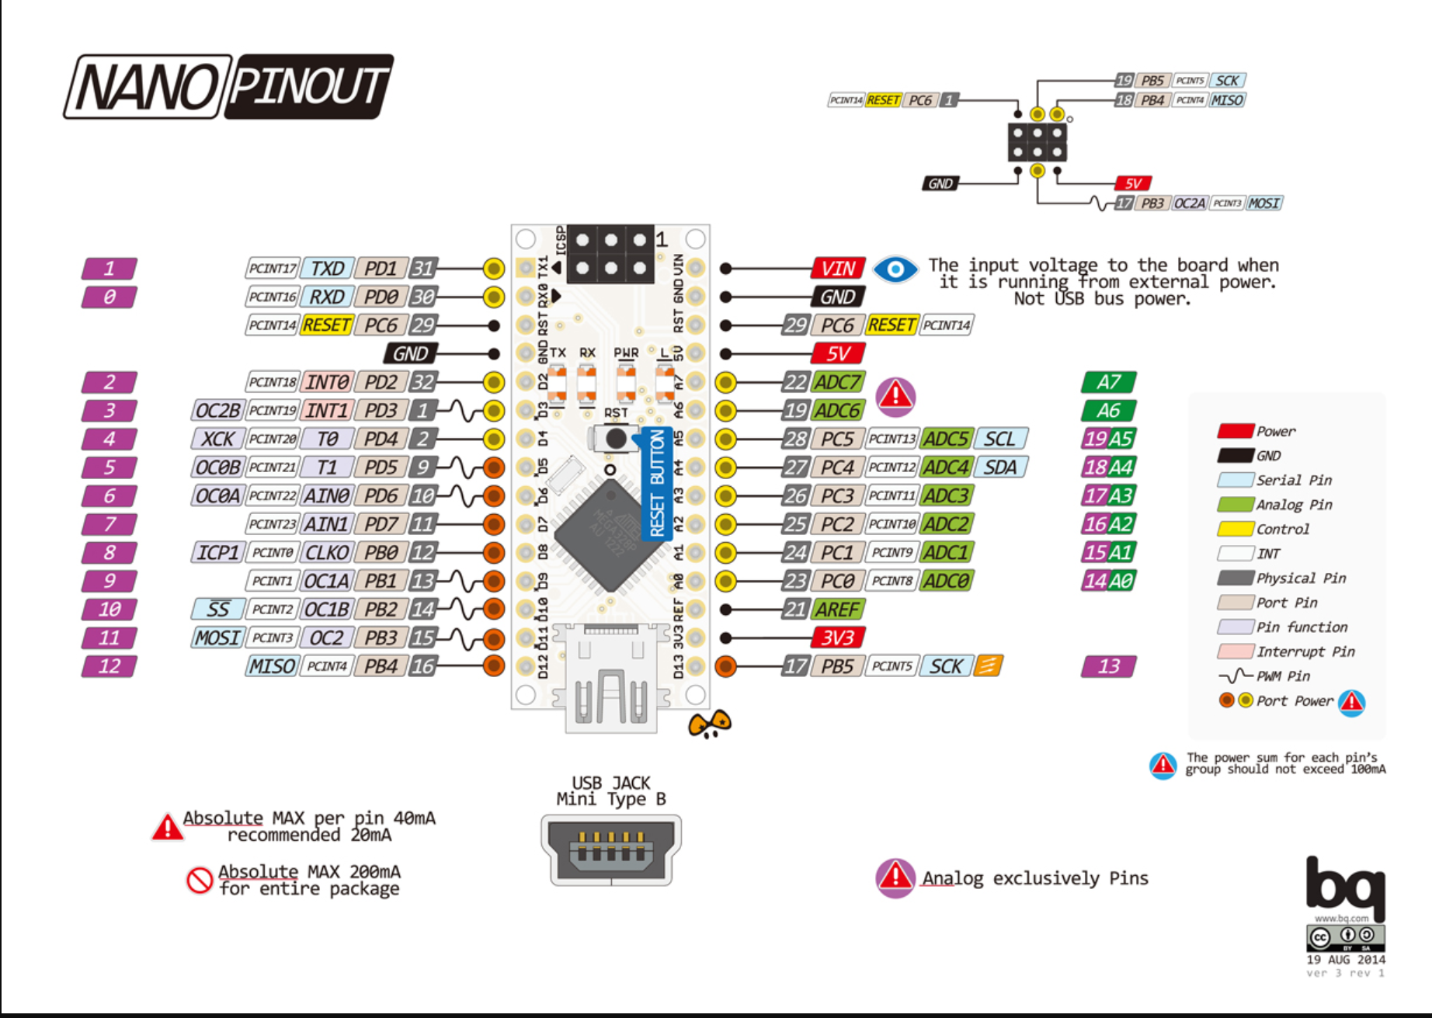
INFO About Arduino NANO – Pin Mappings

